Slide 1
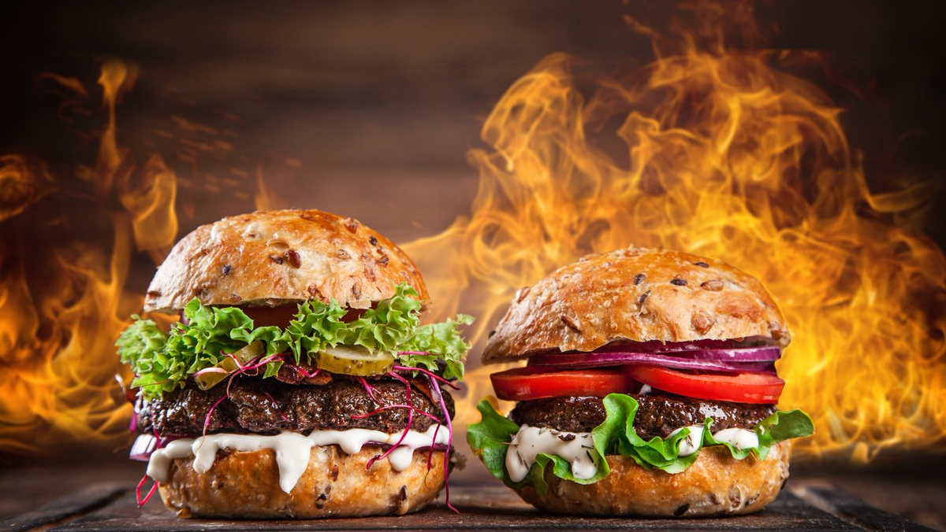
ezFood
Maximizing food efficiency
Notes:
Accelerate local economy

Slide 2
The ezFood Process
1. Customer orders via app
2. Order received and meals prepared by restaurant
3. Meal is finished in time of customers arrival

Slide 3
The ezFood Process
4. Customer orders via app
5. Order received and meals prepared by restaurant
6. Finished order is delivered by ezFoodDrones

Slide 4
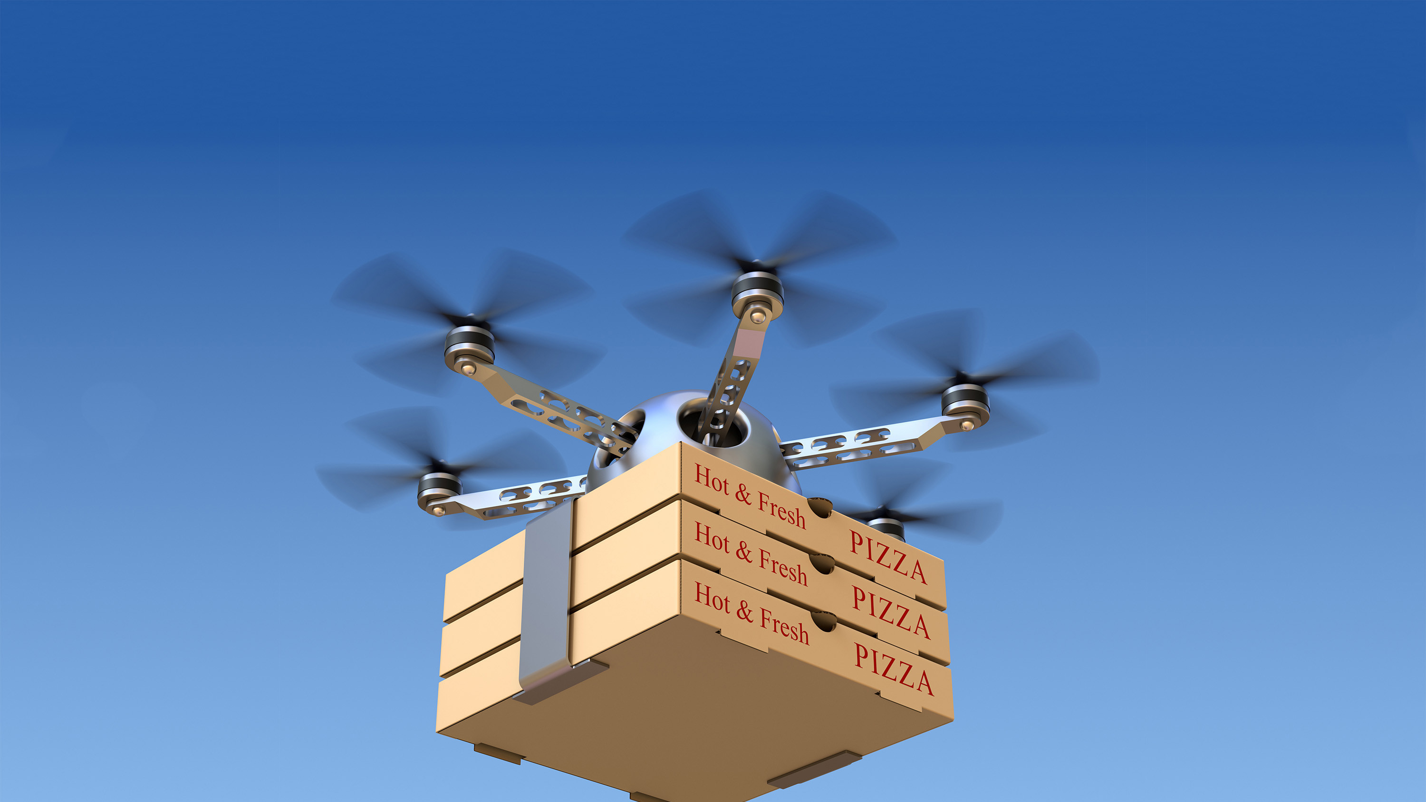
ezFoodDrones
Drone delivery maximizes efficiency
24/7 delivery infrastructure
Operating expense minimisation
Traffic overriding delivery
Notes:
Drone delivery lowers average fixed costs by drastically reducing labour expenses. Efficiency is maximized by having a 24/7 delivery system autarchically.

Slide 5

Main Financial Aspects
Digital ordering system
Drones & EMS
Inventory of 24/7 Snacks in multiple locations
Minimized Labor expenses
Notes:
EMS=Energy management system -> solar + Inverter + potential changer + batteries + charging units

Slide 6
USP´s & UVP´s
Digital ordering system
Drones & EMS
24/7 off-grid infrastructure
Minimized Labor expenses
Rapidly growing user-base
Rapidly growing partnership count
Notes:
EMS=Energy management system -> solar + Inverter + potential changer + batteries + charging units

Slide 7
100% Equity

Slide 8
Valuation
ezFoods is currently valued at 15 million US$ with a 8 million share Volume
Notes:
EMS=Energy management system -> solar + Inverter + potential changer + batteries + charging units

Slide 9
We are looking for an investment of 10% Equity
Notes:
1.5 million

Slide 10
Market Demography
18 – 35 year olds

Slide 11
Analysis of competition

Slide 12
Operating Expenses & ROI
Initial Set Up Cost: 500,000
Operating Expenses/month: 20,000
Expected ROI: 5yrs minimum at optimist growth rate

Slide 13
Timeline
Set up of infrastructure
Partnering with new restaurants
Scale!

